Slide 1

Run-III Dileptonic Top Quark Pair Production Cross-section Measurement Introduction
credits: TTXS members and FNAL staffs

Slide 2







TTXS Facilitators
Alice Bean
Lingqiang He
Daniel Li
Yibo Zhong
Beren Ozek
Aidan Grummer
Roy Candelaria

Slide 3
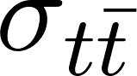
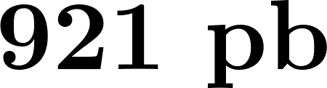
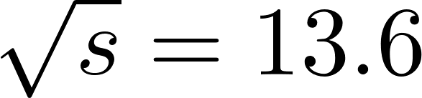


Introduction
“ rises to at TeV from 834 pb in Run 2.”
“We expect sensitivity on the order of ( lumi).”
Top-antitop quark production cross-section is an important attribute to validate the Standard Model (SM) physics. It can also be used as a probe to access new physics among many observables provided by the LHC.
The CMS collaboration expects to gain 10% increase in the x-sec from 13 TeV to 13.6 TeV with PDF4LHC21 predictions. (TOP-22-012)

Slide 4
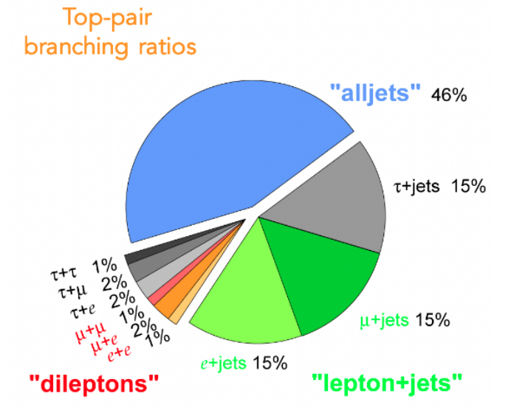
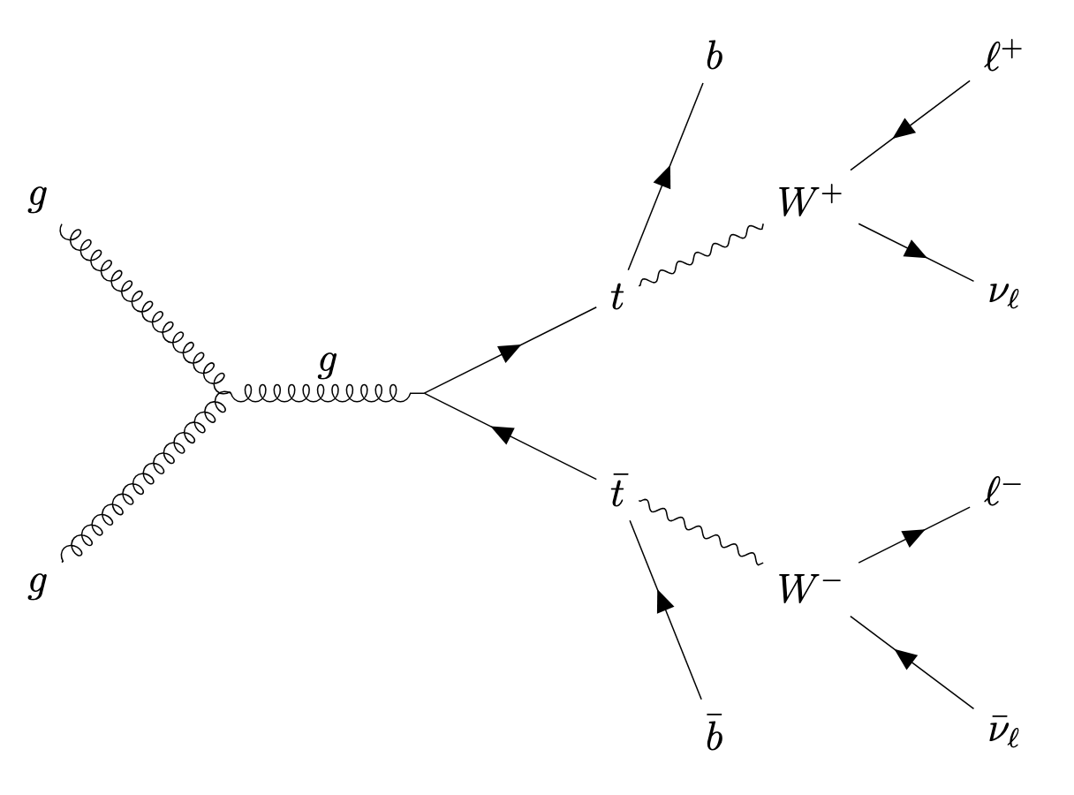
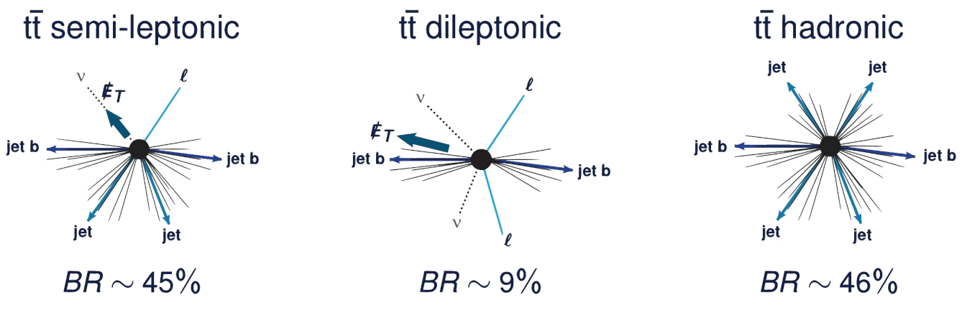
Top Pair Decay Channels
dileptonic production cross-section
ex. dileptonic decay via gg fusion

Slide 5
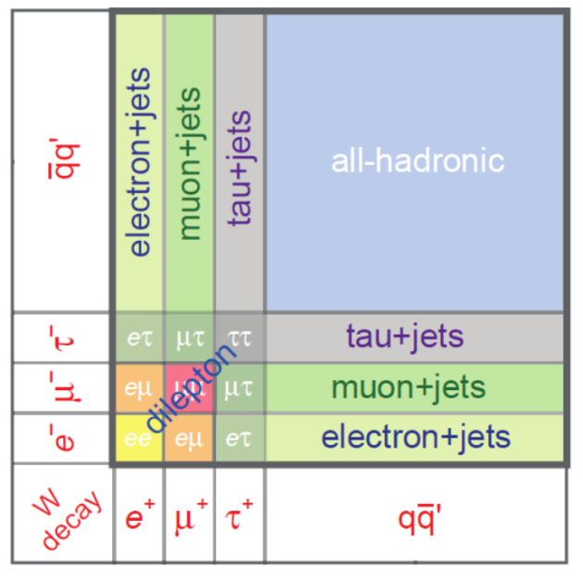
Signal Selection
Lepton pair with opposite signs at high p_{T}
ee, eμ, μμ, e+jets, μ+jets
Not including leptonic tau decays
At least 1 b-tagged jet

Slide 6
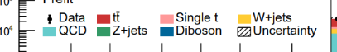
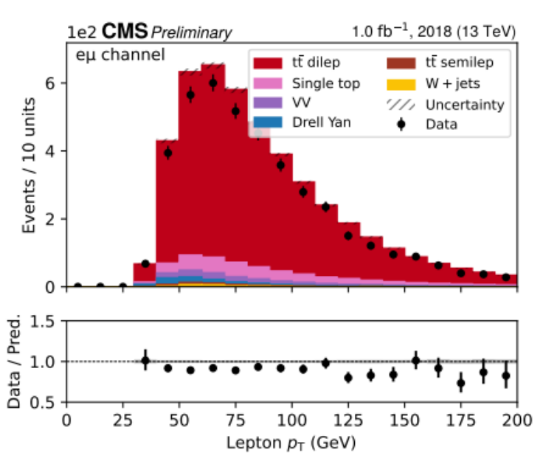
Background Events
V+Jets
SingleTop
QCD
Diboson
…

Slide 7
Data & MC Samples
Luminosity of 1.23 fb⁻¹ of certified data from Era C (golden JSON from 16.08.)
MuonEG, Egamma, Muon DoubleMuon data stream [Look up the definitions here]
Single & Dilepton high level triggers (HLT) applied

Slide 8
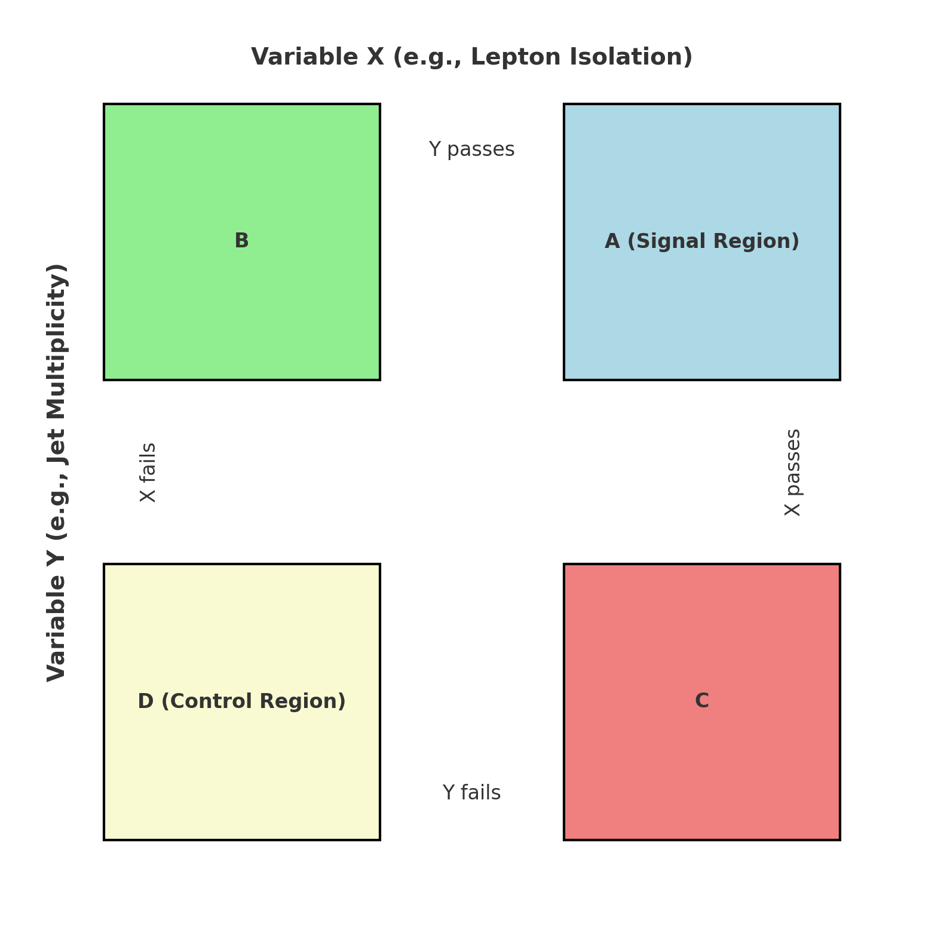
The ABCD Method
Region A: Signal Region (SR)
Meets both selection criteria (e.g., tight isolation and a certain jet multiplicity).
Contains contributions from both signal and background.
Region B: Background Region 1
Meets one selection criterion but fails the other (e.g., loose isolation).
Region C: Background Region 2
Fails the first criterion but meets the second.
Region D: Control Region
Fails both selection criteria.
Notes:
A modified ABCD method applied in the actual analysis. Find the details in the appendix of the analysis note.

Slide 9
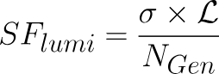
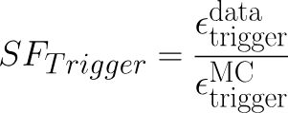
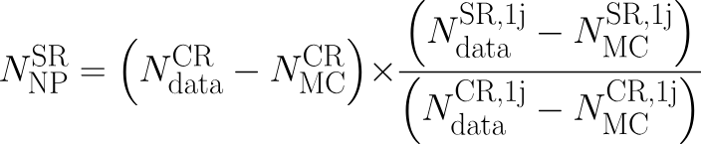
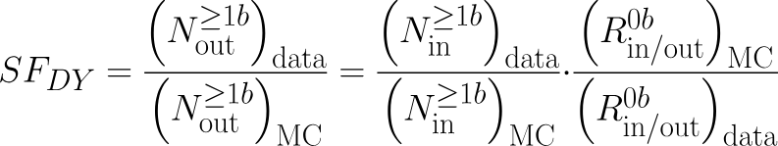
Scale Factors
Lumi SF
Trigger SF
Non-prompt SF
Drell-Yan SF
5. BTagging SF
Notes:
They used the modified ABCD method in top-22-012 to avoid signal contamination that might introduce circularity since xsec is unknown
Rin/out​: The ratio of events inside (NinN_{\text{in}}Nin​) to outside (NoutN_{\text{out}}Nout​) the Z-peak sideband region in the invariant mass (mℓℓm_{\ell\ell}mℓℓ​) distribution. It quantifies how the Drell-Yan process distributes across different kinematic regions
Instead of directly assuming that the Monte Carlo (Rin/outMCR_{\text{in/out}}^{\text{MC}}Rin/outMC​) matches the data (Rin/outdataR_{\text{in/out}}^{\text{data}}Rin/outdata​), the ratio of these quantities for events with ≥1\geq 1≥1 b-tag jets is compared to events with 000 b-tags, which relaxes the assumption that modeling is perfect across all regions:

Slide 10
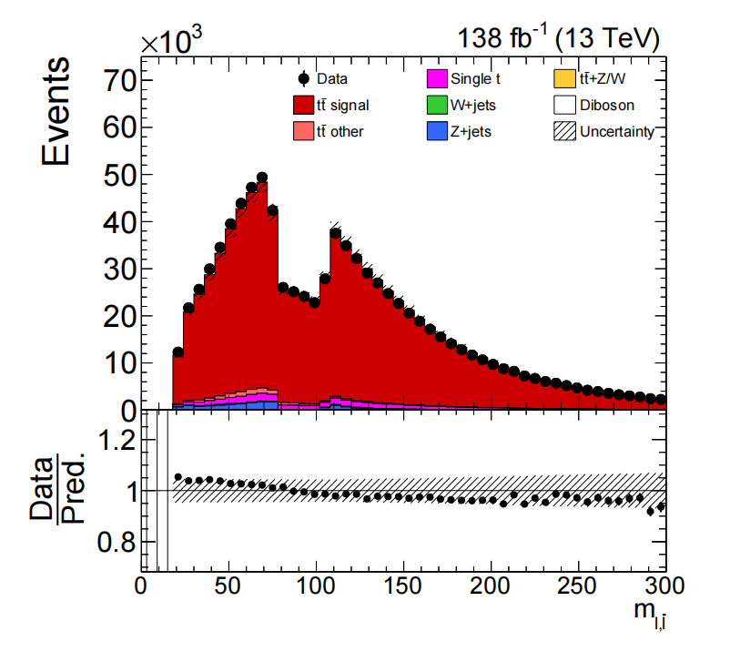
Event Selections
ex. excluded Z peak in mutual-flavor lepton pairs
Electrons: p_{T} > 35 GeV, |η| < 2.4
tight cut-based ID
|η_{SC}| not in [1.444; 1.566]
Muons: p_{T} > 35 GeV, |η| < 2.4
tight cut-based ID, tight ISO
m_{ℓℓ} > 20 GeV
Z peak: remove 76 GeV < m_{ℓℓ} < 106 GeV (ee and µµ only)
No MET Cuts
[TOP-23-006]

Slide 11
Jet Selections
Charged Hadron Subtraction (CHS), Tight jet ID
|η| < 2.4
p_{T} > 30 GeV
Notes:
CHS is an essential component of the CMS pileup mitigation strategy, focusing on identifying and subtracting contributions from charged hadrons not originating from the primary vertex. Should we include JEC/JES here?

Slide 12
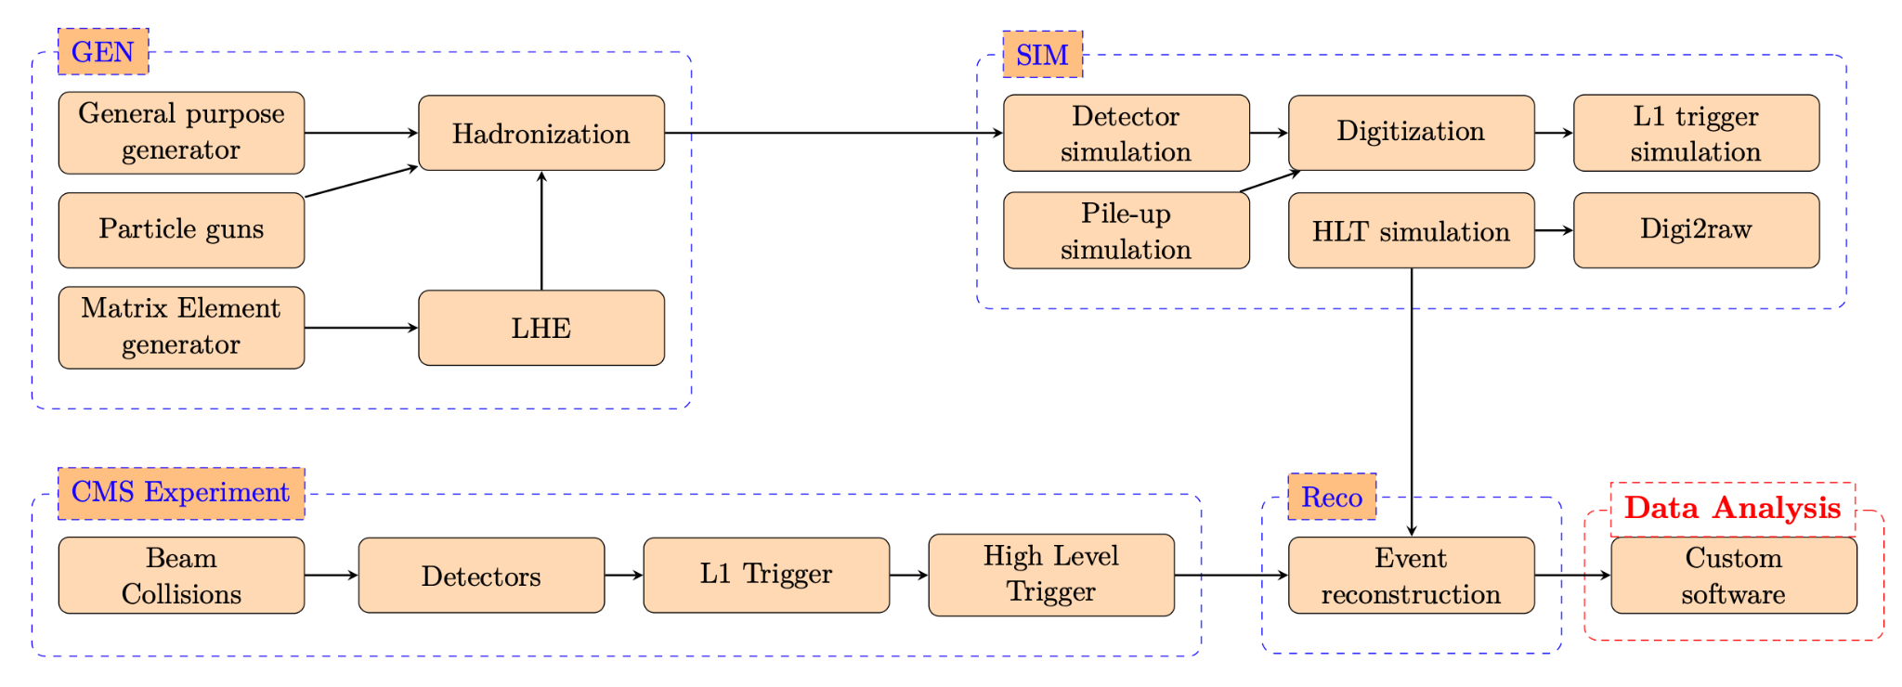

Slide 13


Common Analysis Tools
Columnar Analysis in Python
Pepper
Coffea
Uproot
NanoAODSchema
Awkward Array
Anaconda & Jupyter-lab
A convenient UI
Support many formats, as competitive as MS VisualStudio
[OpenAI image]

Slide 14
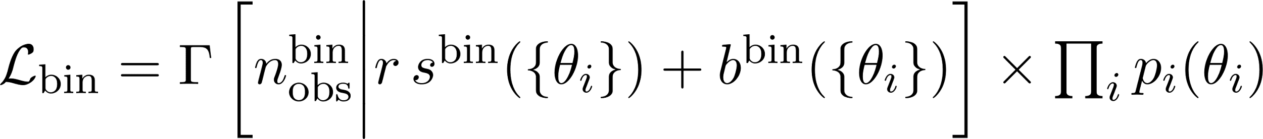
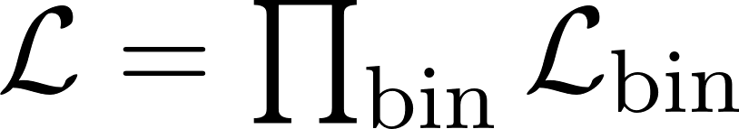
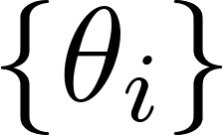
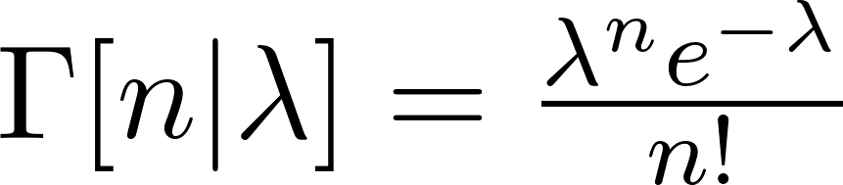
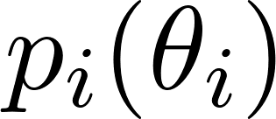
Statistical Method
Likelihood fit via Combine Tool
Overall Likelihood Function
s - signal
b - background
- nuisance parameters
- penalties
Poisson Distribution

Slide 15
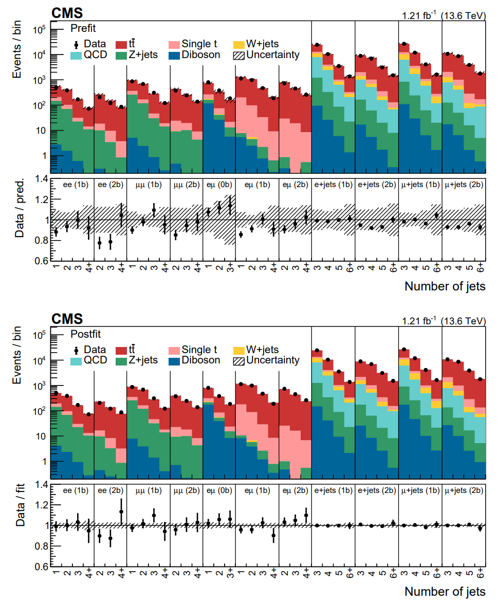
Statistical Method
prefit (top) vs. postfit (bottom)
pay attention to
normalization changes
changes in uncertainties
[TOP-22-012]

Slide 16
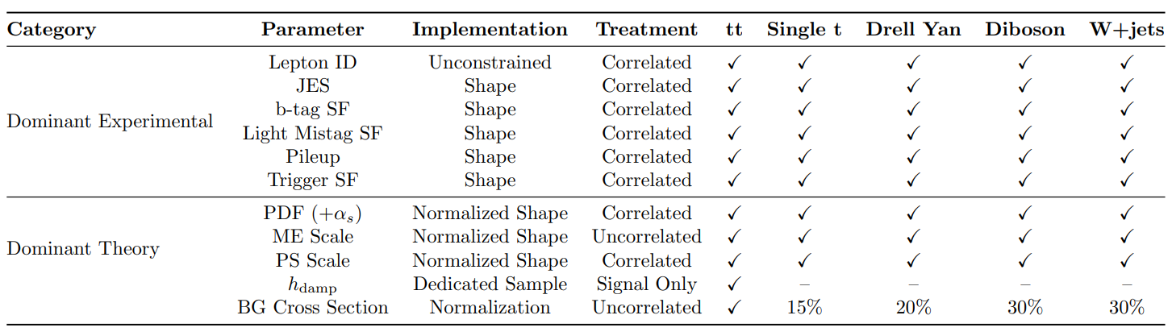
Statistical Method
Externalized: Lumi
Included in LL fit:
check out do_syst_table.py
for the systematic uncertainty names

Slide 17
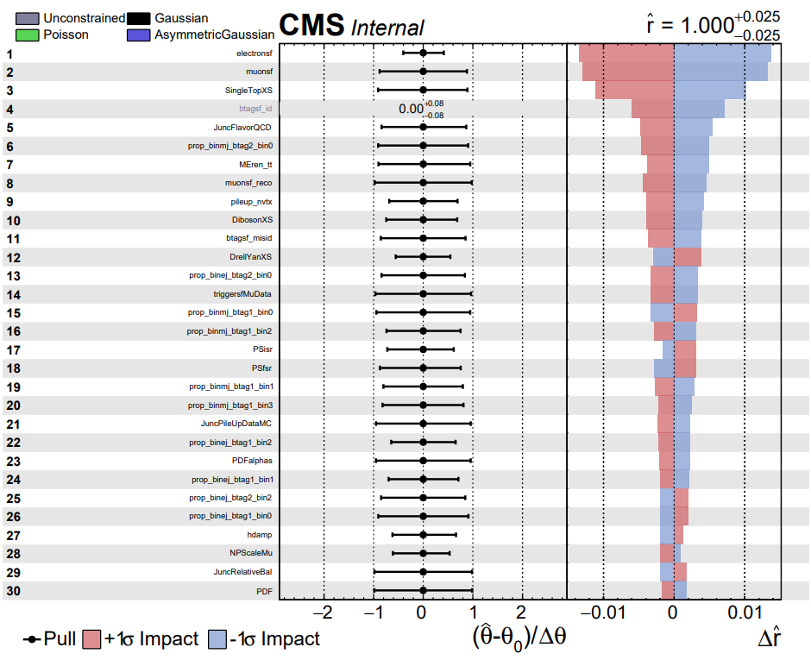
Statistical Method
Summarize the effect of nuisance parameters on the best-fit value of the signal strength parameter r.
A well-behaved fit typically has most pulls within ±1σ, indicating that the data reasonably constrain the nuisance parameters
[TOP-22-012]
Notes:
Left: change in nuisance parameter from prefit to postfit Right: impact of each nuisance parameter when shifted by 1 sigma

Slide 18

“It’s time to stop!”
Now we take a break and divide into two groups.
Group 1: Fill the histograms with lumi SF. Consider what samples to include in the control plots. Consider parton shower variation. Plot electron ID SF vs. nominal.
Group 2: Also fill the histograms with lumiSF. Consider pile-up reweighting. Plot muon ID SF vs. nominal.

Slide 19
Back Up

Slide 20
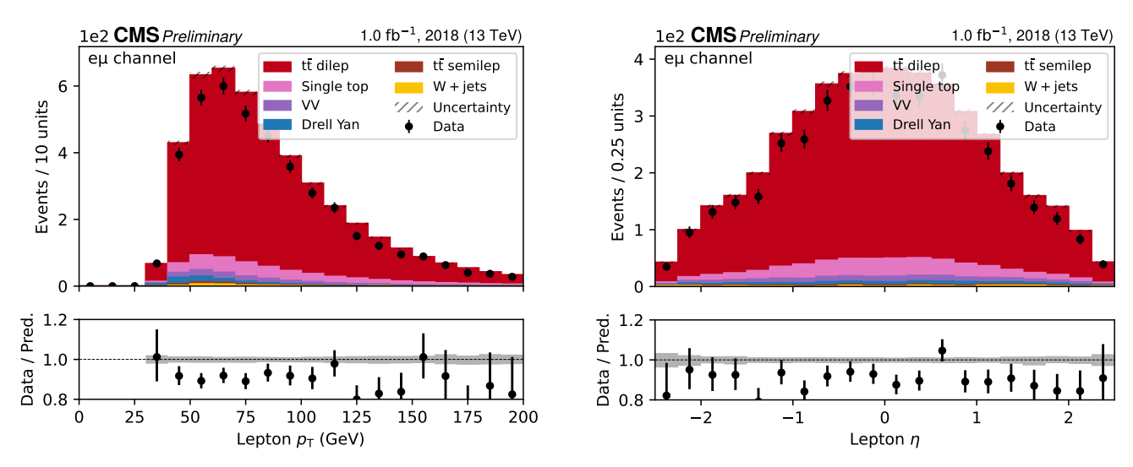
Actual Stack Plots in AN

